Slide 1
SALES DASHBOARD USING EXCEL
SUNNY KUMAR

Slide 2
Objective of project
To collect and analyze multi-region sales data to understand variations in buying behavior.
To research the effectiveness of current sales and marketing strategies in global markets.

Slide 3
CONTENTS
SHEET 1 INPUT DATA
SHEET 2 TARGET OF THE STORE
SHEET 3 CUSTOMER DETAILS
SHEET 4 PIVOT TABLES
DASHBOARD

Slide 4
FORMULA USED
USED PRODUCT FUNCTION TO FIND THE TOTAL AMOUNT GENERATED AFTER SELLING
VLOOKUP FUNCTION USED TO COUNTRY NAME OF CUSTOMER FROM CUSTOMER SHEET
USED =TEXT([@DATE],"mmm") TO FIND MONTH NAME
USED =WEEKNUM([@DATE]) TO FIND THE WEEK NUMBER IN THE YEAR
USED VLOOKUP FUNCTION TO CALCULATE MONTHLY SALES AND COMPARED WITH TARGET

Slide 5
TOP SELLING PRODUCT
Product30 | 57,969
Product41 | 57,554
Product24 | 49,599
Product19 | 41,580
Product22 | 41,055
Product32 | 40,883
Product21 | 39,660
Product05 | 38,591
Product42 | 38,232
Product10 | 34,992

Slide 6
TOP 3 CUSTOMERS
Customer33 | 60,929
Customer22 | 45,113
Customer23 | 43,063

Slide 7
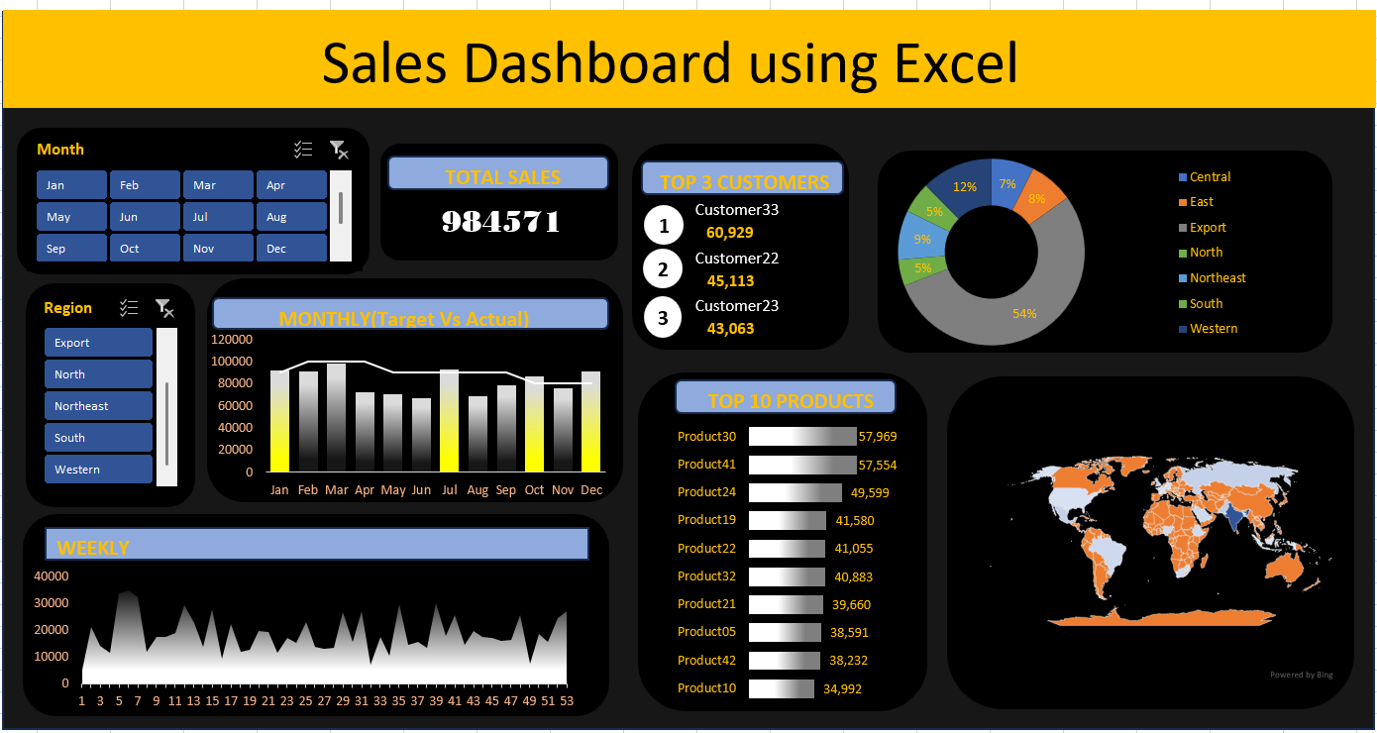
DASHBOARD OVERVIEW

Slide 8
CONCLUSION
The sales dashboard successfully summarizes essential sales metrics,
enabling quick decision-making and improving business insights.

